Slide 1
The Data Link Layer
Chapter 3

Slide 2
3.1 Data Link Layer Design Issues
Object : reliable, efficient communication between two adjacent machines.
Services Provided to the Network Layer
Framing(成帧)
Error Control(错误控制)
Flow Control(流量控制)

Slide 3
Functions of the Data Link Layer
Provide service interface to the network layer
Dealing with transmission errors
Regulating data flow
Slow receivers not swamped by fast senders

Slide 4
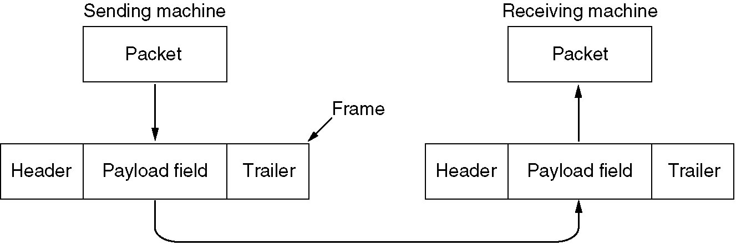
Functions of the Data Link Layer (2)
Relationship between packets and frames.

Slide 5
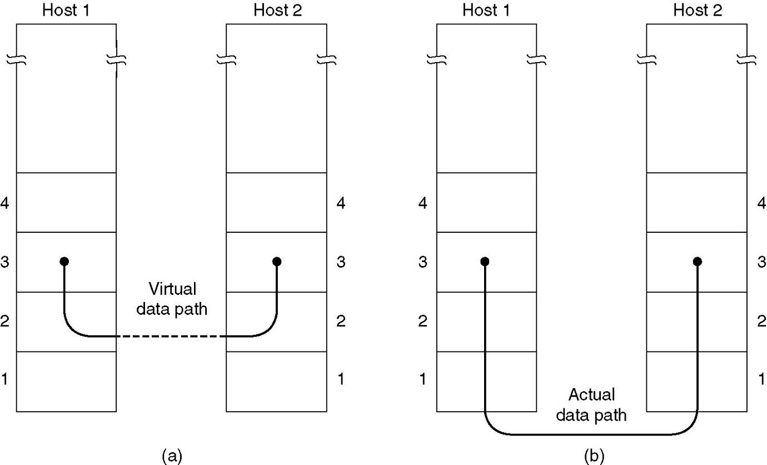
Services Provided to Network Layer
(a) Virtual communication.
(b) Actual communication.

Slide 6
Services Provided to Network Layer(2)
Various services
Unacknowledged connectionless service, appropriate for
Error rate is very low
Real-time traffic, late data are worse than bad
Most LANs .
Acknowledged connectionless service.
Unreliable channels, such as wireless systems
Acknowledged connection-oriented service.
WAN , Point to point
Establish connection, transmit frames, release connection
Each frame sent is indeed received exactly once, all frames are received in the right order.

Slide 7
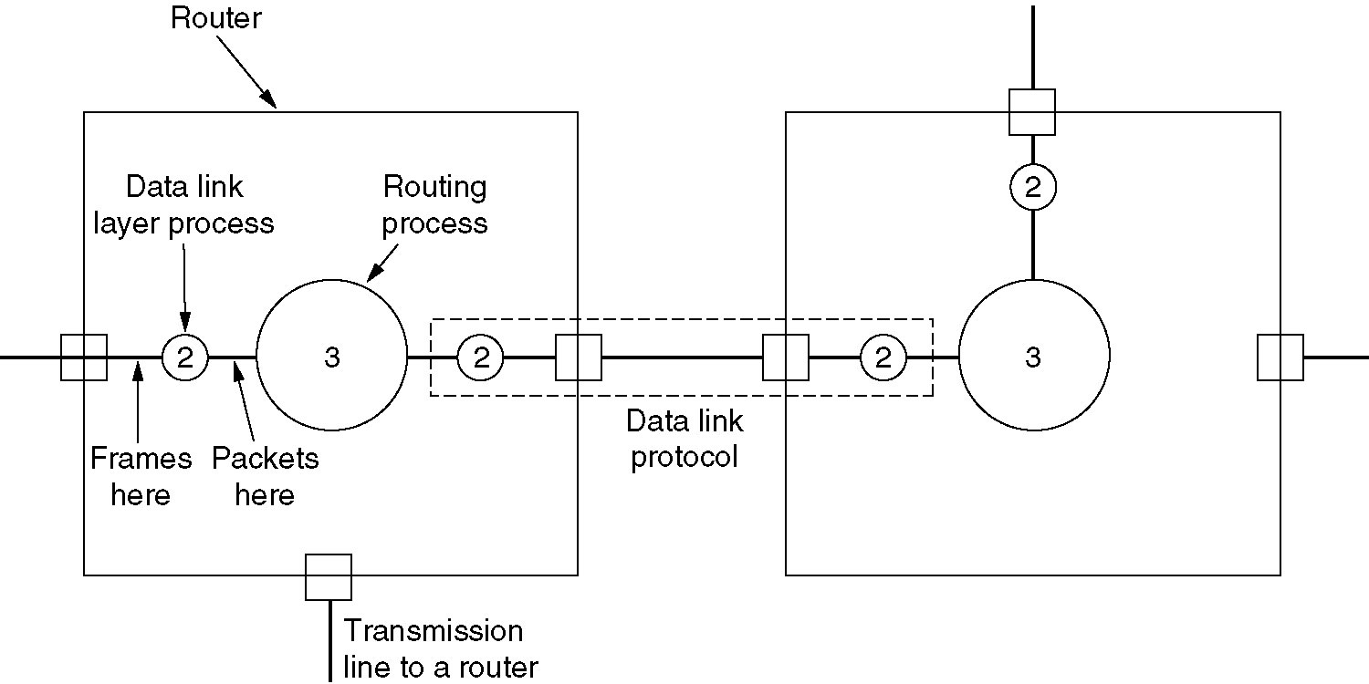
Services Provided to Network Layer (3)
Placement of the data link protocol.

Slide 8
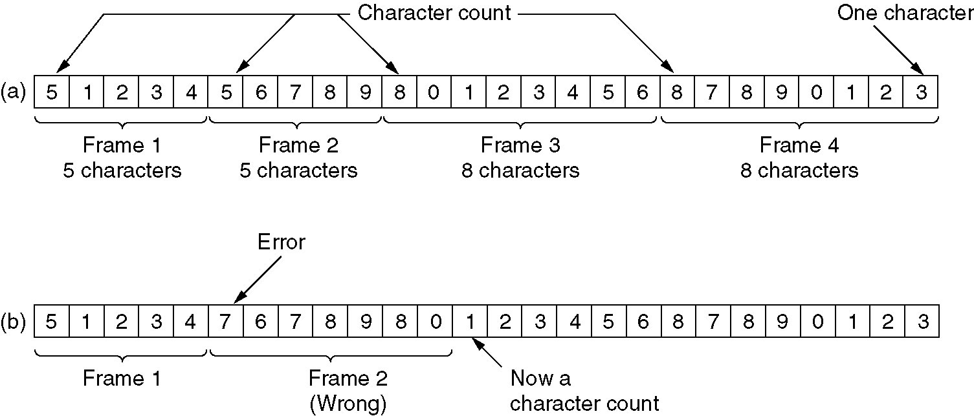
Framing
1.Character count (字符计数法)
A character stream. (a) Without errors. (b) With one error.

Slide 9
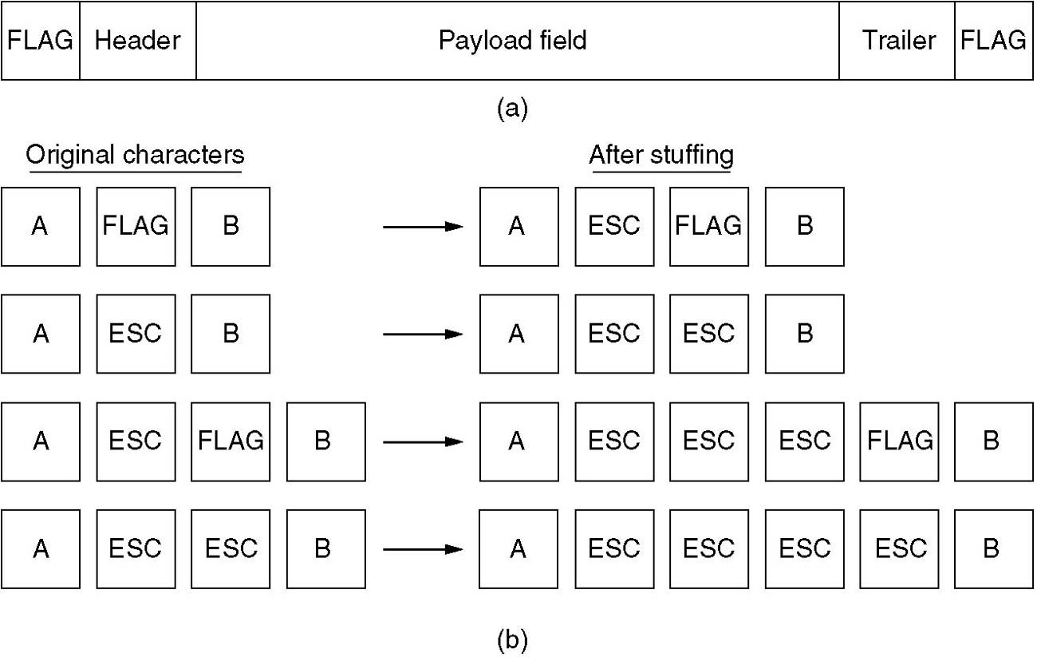
Framing (2)
2.Flag bytes with byte stuffing(字符填充法 )
(a) A frame delimited by flag bytes.
(b) Four examples of byte sequences before and after stuffing.

Slide 10
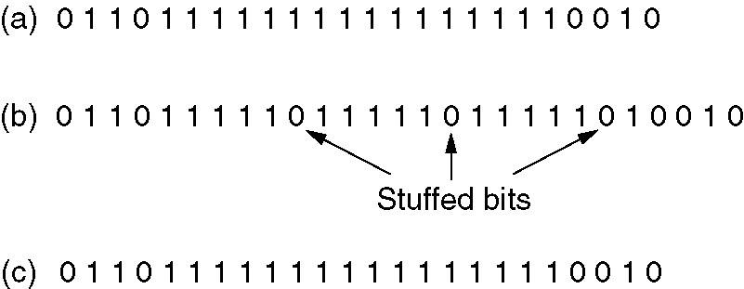
Framing (3)
3.Starting and ending flags, with bit stuffing(位填充法)
Bit stuffing
(a) The original data.
(b) The data as they appear on the line.
(c) The data as they are stored in receiver’s memory after destuffing.

Slide 11
Framing (4)
4.Physical layer coding violations(物理层违例编码法)
Manchester encoding
0: first low and then high;
1: first high and then low
First low and then low or first high and then high is violative code.

Slide 12
Error Control
All frames are eventually delivered to the destination and in the proper order
Error detect
Feedback, positive or negative acknowledgement
T
Sequence number
Retransmission and reorder

Slide 13
Flow Control
Sender wants to transmit frames faster than the receiver can accept them.
Feedback-based flow control, permission
Rate-based flow control

Slide 14
3.2 Error Detection and Correction
Error-Correcting Codes
Hamming codes
Binary convolutional codes
Reed-Solomon and Low-Density Parity Check codes
Mathematically complex, widely used in real systems
Error-Detecting Codes
Parity
Checksums
Cyclic redundancy codes

Slide 15
Hamming distance
Hamming distance is the minimum bit flips to turn one
valid codeword into any other valid one.
Example with 4 codewords of 10:
0000000000, 0000011111, 1111100000, and 1111111111
Hamming distance is 5
Bounds for a code with distance:
2d+1 – can correct d errors(e.g., 2 errors above)
d+1 – can detect d errors(e.g., 4 errors above)

Slide 16
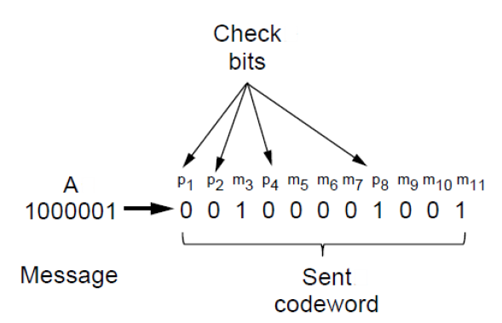
Error Correction -Hamming codes(1)
Hamming code gives a simple way to add check bits and correct up to a single bit error.
Hamming code include m message bits and r check bits:
(m+r+1)≤2^{r}

Slide 17
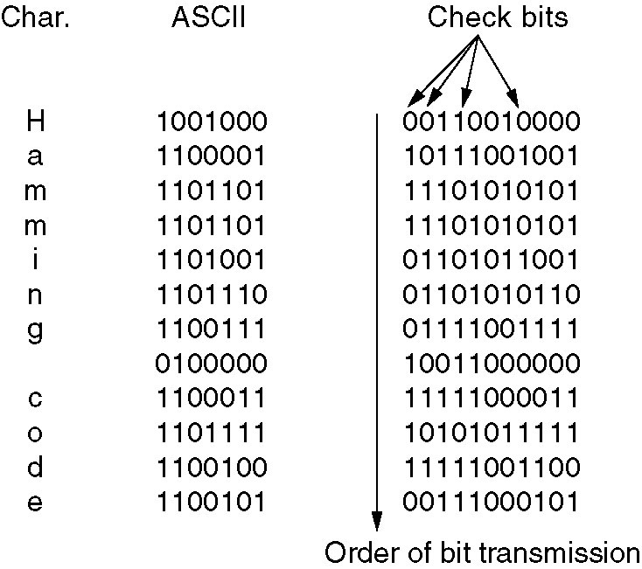
Hamming codes(2)
Use of a Hamming code to correct burst errors.

Slide 18
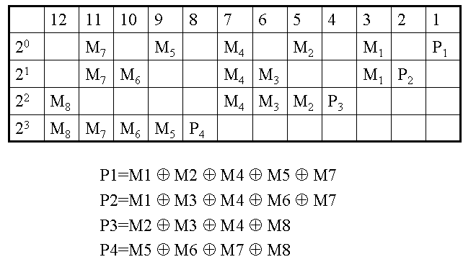
Hamming codes(3)
Example
“H”=1001000
P₁=M₁⊕M₂ ⊕ M₄ ⊕ M₅ ⊕ M₇=1 ⊕ 0 ⊕ 1 ⊕ 0 ⊕ 0=0
P₂=M₁ ⊕ M₃ ⊕ M₄ ⊕ M₆ ⊕ M₇=1 ⊕ 0 ⊕ 1 ⊕ 0 ⊕ 0=0
P₃=M₂ ⊕ M₃ ⊕ M₄ ⊕ M₈=0 ⊕ 0 ⊕ 1 ⊕0 =1
P₄=M₅ ⊕ M₆ ⊕ M₇ ⊕ M₈=0 ⊕ 0 ⊕ 0 ⊕ 0=0
Codeword=00110010000

Slide 19
Error-Correcting Codes(4)
海明码是由R. Hamming在1950年首次提出的，它也是一种可以纠正一位差错的编码。
海明码能发现多位错误,但只能纠正一位错，若用在纠正传输中出现突发性差错时可以采用下述方法:将连续P个码字排成一个矩阵，每行一个码字。如果发生突发长度≤P的突发错误，那么在P个码字中最多每个码字有一位有差错，正好由海明码能纠正。

Slide 20
Error Detection – Parity (1)
Parity bit is added as the modulo 2 sum of data bits
Equivalent to XOR; this is even parity
Ex: 1110000 → 11100001
Detection checks if the sum is wrong (an error)
Simple way to detect an odd number of errors
Ex: 1 error, 11100101; detected, sum is wrong
Ex: 3 errors, 11011001; detected sum is wrong
Ex: 2 errors, 11101101; not detected, sum is right!
Error can also be in the parity bit itself
Random errors are detected with probability ½

Slide 21
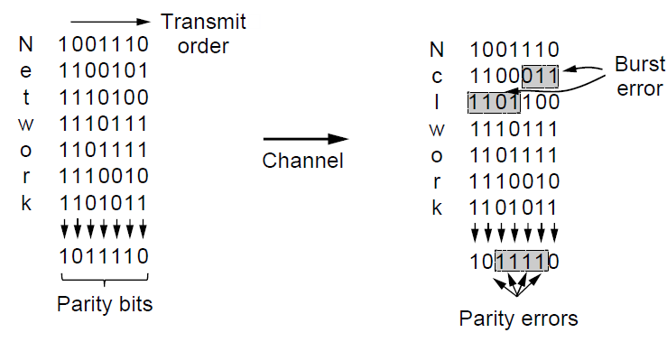
Error Detection – Parity (2)
Interleaving of N parity bits detects burst errors up to N
Each parity sum is made over non-adjacent bits
An even burst of up to N errors will not cause it to fail

Slide 22
Error Detection – Checksums（1）
Checksum treats data as N-bit words and adds N check bits that are the modulo 2^{N} sum of the words
Ex: Internet 16-bit 1s complement checksum
Properties:
Improved error detection over parity bits
Detects bursts up to N errors
Detects random errors with probability 1-2^{N}
Vulnerable to systematic errors, e.g., added zeros

Slide 23
Checksum Calculation（2）
发送端
接收端
字 1
16 位
字 1
16 位
数
据
报
首
部
字 2
16 位
字 2
16 位
…
…
检验和
置为全 0
检验和
16 位
…
…
字 n
16 位
字 n
16 位
反码算术/1的补码算法
运算求和
反码算术
运算求和
16 位
16 位
取反码
IP 数据报
取反码
检验和
16 位
结果
16 位
数据部分
不参与检验和的计算
数据部分
若结果为 0, 则保留；
否则，丢弃该数据报

Slide 24
Checksum（Example）
IP Header
0100
0101
00000000
00000000 00011110
4
5
0
30
00000000 00000001
1
0
0
000
00000 00000000
00001010
00010001
10
17
0x D190
0
00000000 00000000
100.
01100100
00001100
12.
14.
5
00001110
00000101
102.
36.
7.
9
01100110
00100100
+
00000111
00001001
Checksum：0x D190
1 00101110 01101110
+
1
取
反
11010001 10010000
00101110 01101111

Slide 25
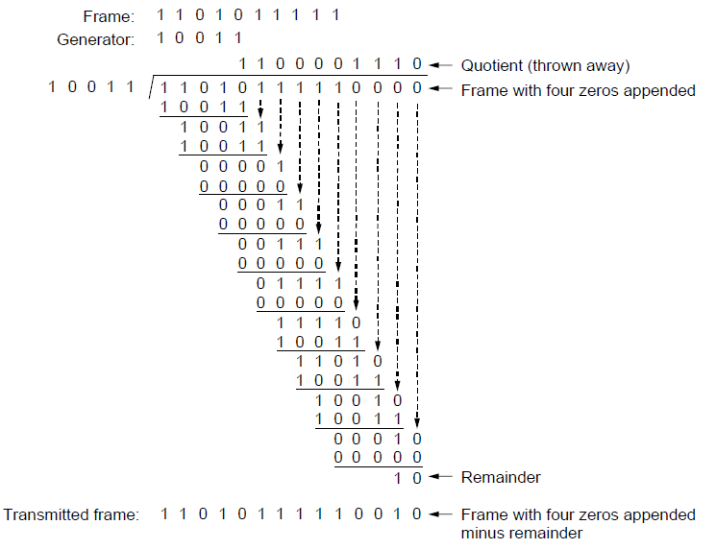
Error Detection – CRCs (1)
Adds bits so that transmitted frame viewed as a polynomial is evenly divisible by a generator polynomial
Start by adding 0s to frame and try dividing
Offset by any reminder to make it evenly divisible

Slide 26
Error-Detecting Codes(2)
Sender and receiver must agree upon a generator polynomial, G(x).
Both the high- and low-order bits of the generator must be 1.
The frame with m bits, corresponding to the polynomial M(x), must be longer than the generator polynomial.
To append a checksum to the end of the frame
When the receiver gets the checksummed frame, it tries dividing it by G(x).
If there is a remainder, there has been a transmission error.

Slide 27
Error-Detecting Codes(3)
The algorithm for computing the checksum is as follows:
Let r be the degree of G(x). Append r zero bits to the low-order end of the frame so it now contains m + r bits and corresponds to the polynomial x^{r}M(x).
Divide the bit string corresponding to G(x) into the bit string corresponding to x^{r}M(x), using modulo 2 division.
Subtract the remainder (which is always r or fewer bits) from the bit string corresponding to x^{r}M(x) using modulo 2 subtraction.
The result is the checksummed frame to be transmitted. Call its polynomial T(x).

Slide 28
Error-Detecting Codes(4)
The power
Catch all errors consisting of an odd number of inverted bits
A polynomial code with r check bits will detect all burst errors of length <= r.
A simple shift register circuit can be constructed to compute and verify the checksums in hardware

Slide 29
Error Detection – CRCs (5)
Based on standard polynomials:
Ex: Ethernet 32-bit CRC is defined by:
Computed with simple shift/XOR circuits
Stronger detection than checksums:
E.g., can detect all double bit errors
Not vulnerable to systematic errors

Slide 30
3.3 Elementary Data Link Protocols
A Utopian Simplex Protocol（理想化单工协议）
A Simplex Stop-and-Wait Protocol for an Error-Free Channel（无噪声信道单工停-等协议）
A Simplex Stop-and-Wait Protocol for a Noisy Channel （有噪声信道单工停-等协议）

Slide 31
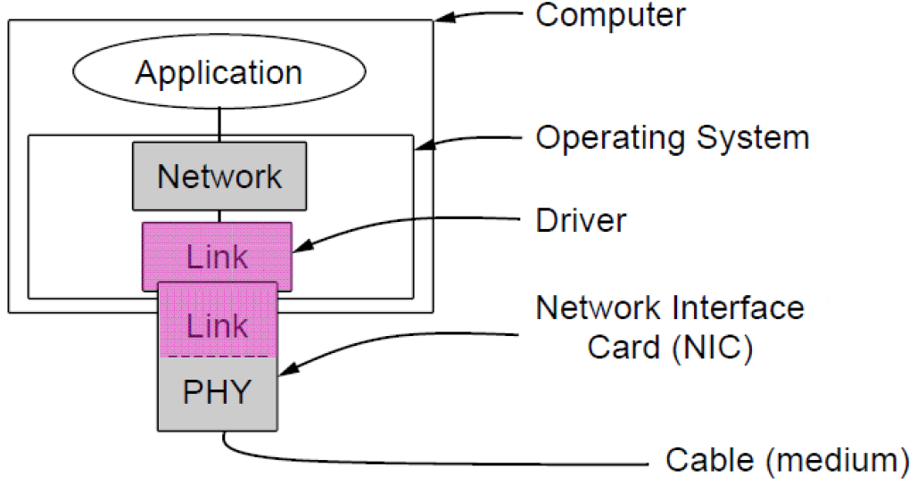
Implementation of the physical, data link, and network layers

Slide 32
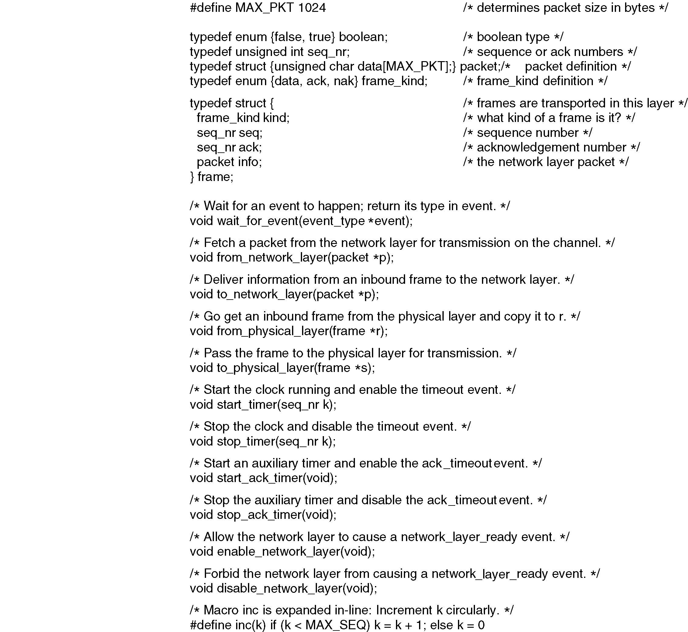
Protocol Definitions
Continued →
Some definitions needed in the protocols to follow. These are located in the file protocol.h.

Slide 33
Protocol Definitions (ctd.)
Some definitions needed in the protocols to follow. These are located in the file protocol.h.

Slide 34
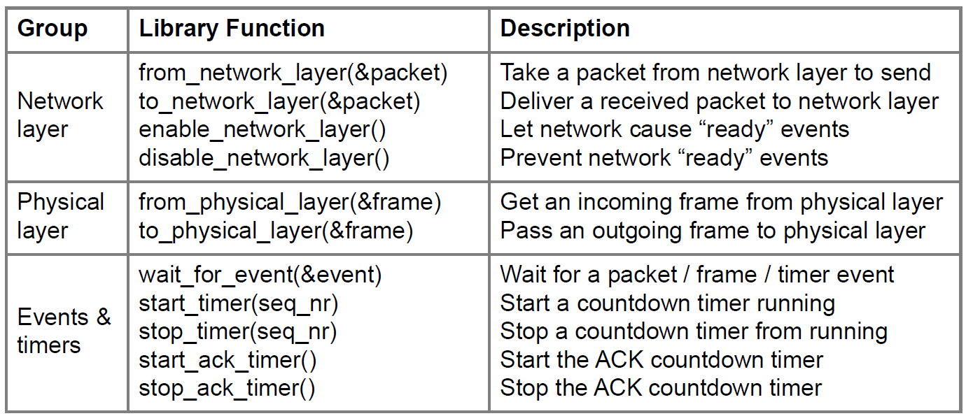
Protocol Definitions (ctd.)
Link layer protocol implementations use library functions

Slide 35
Utopian Simplex Protocol
Assume
Physical layer, data link layer, and network layer are independent processes
One direction transmission
Have a reliable Physical layer service.
Machine A have an infinite supply of data ready to send
Machine B always ready to receive
machines do not crash

Slide 36
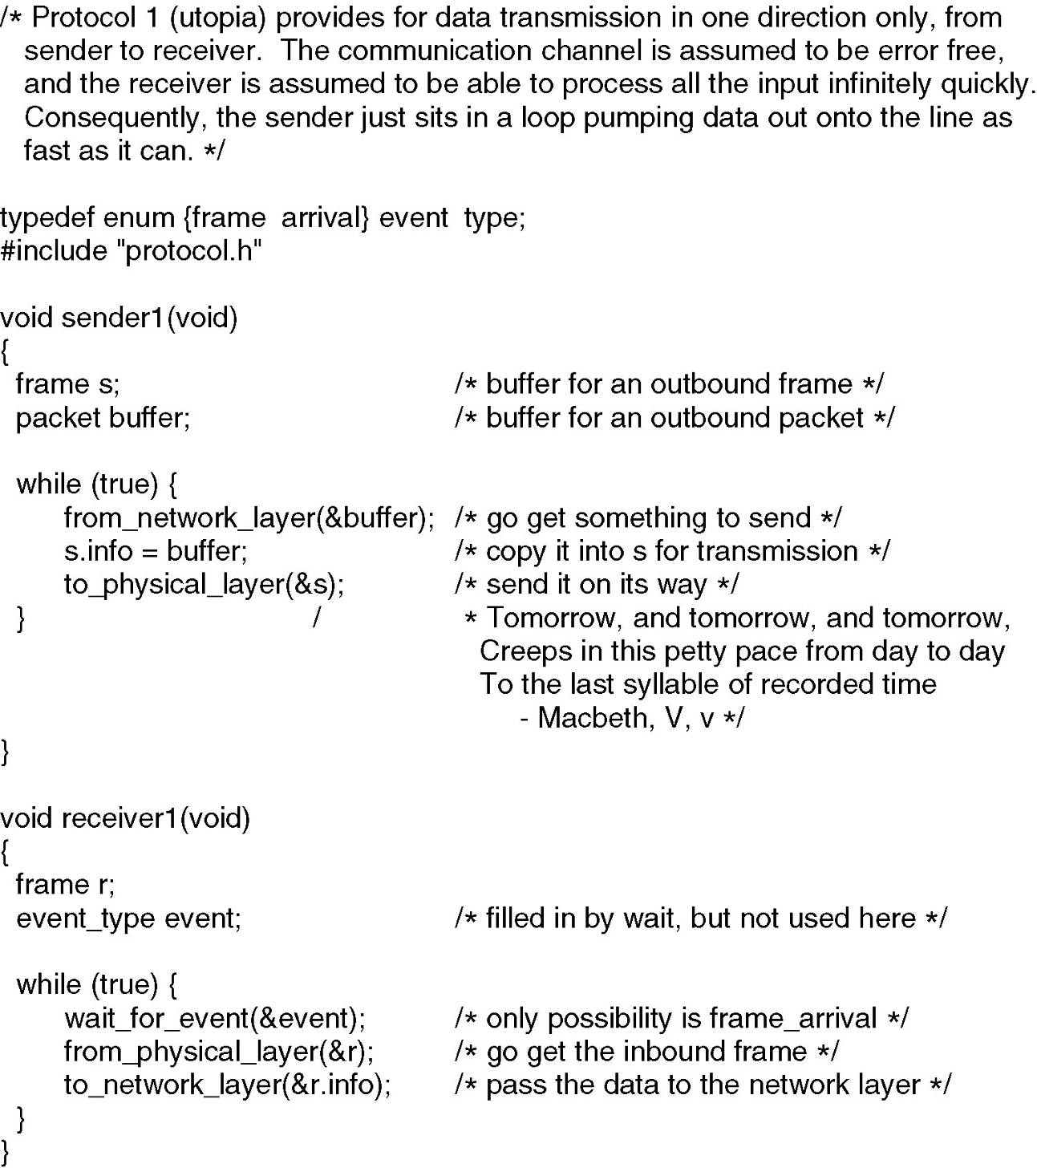
Utopian Simplex Protocol

Slide 37
Simplex Stop-and-Wait Protocol （Error-Free Channel）
Receiver sends Acknowledgement for flow control
Only one frame out at a time – called stop-and-wait

Slide 38
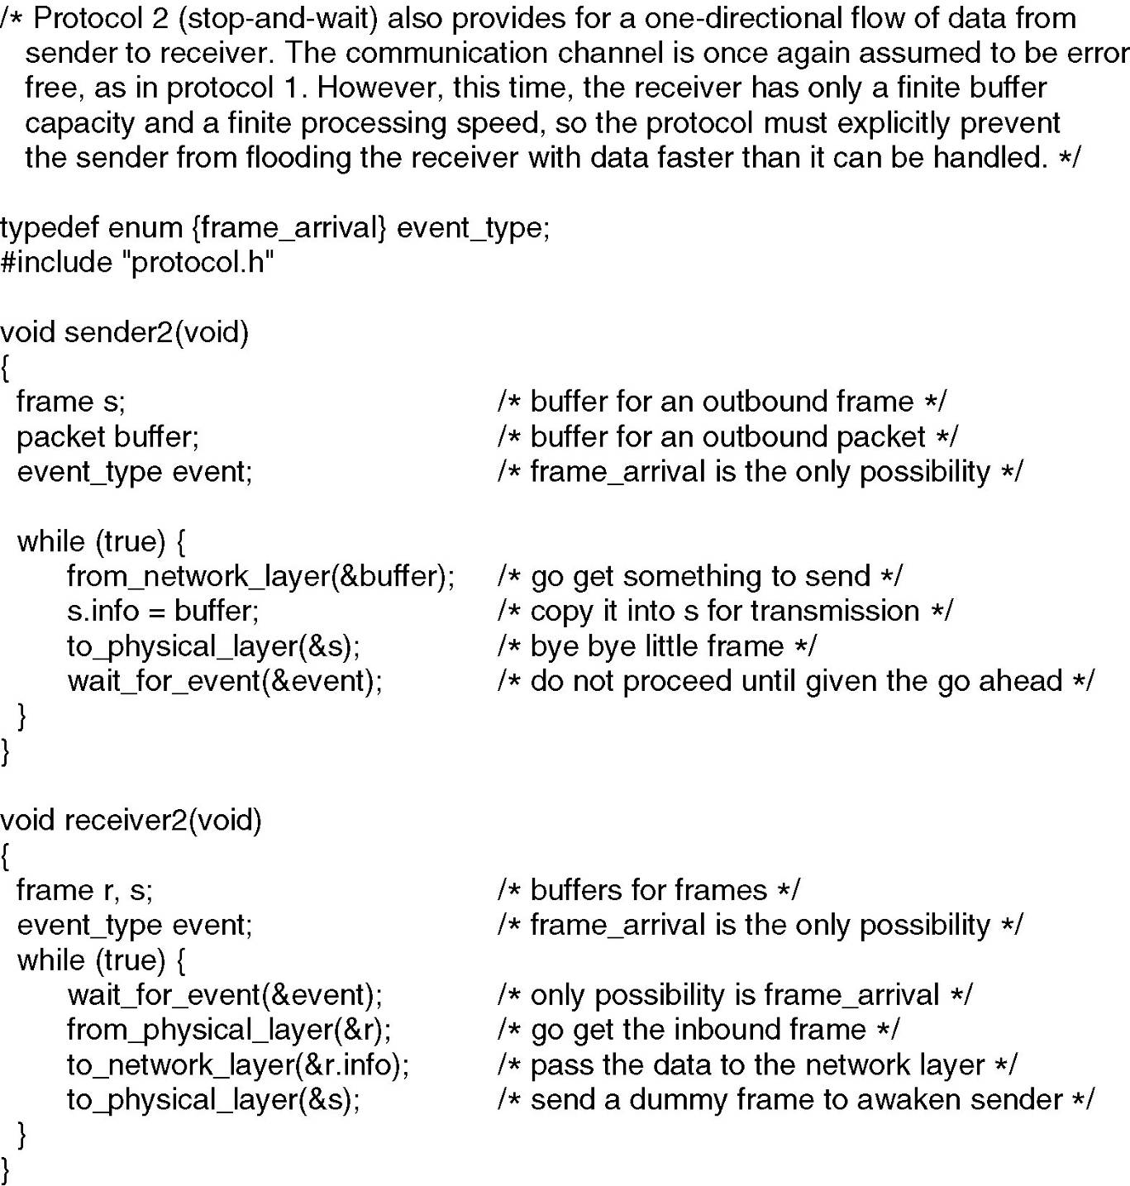
Simplex Stop-and-Wait Protocol

Slide 39
A Simplex Stop-and-Wait Protocol (Noisy Channel)
Unreliable Physical line
Solution（ARQ (Automatic Repeat reQuest)
adds error control）
Sender sends frame with CRC
Receiver verifies CRC value and sends ACK or NAK
Sender sends a new frame when receives an ACK, sends old frame when receives an NAK or timeout.
When ACK lost
Produce a duplicate frame
A 1-bit sequence number to distinguish new or old frame

Slide 40
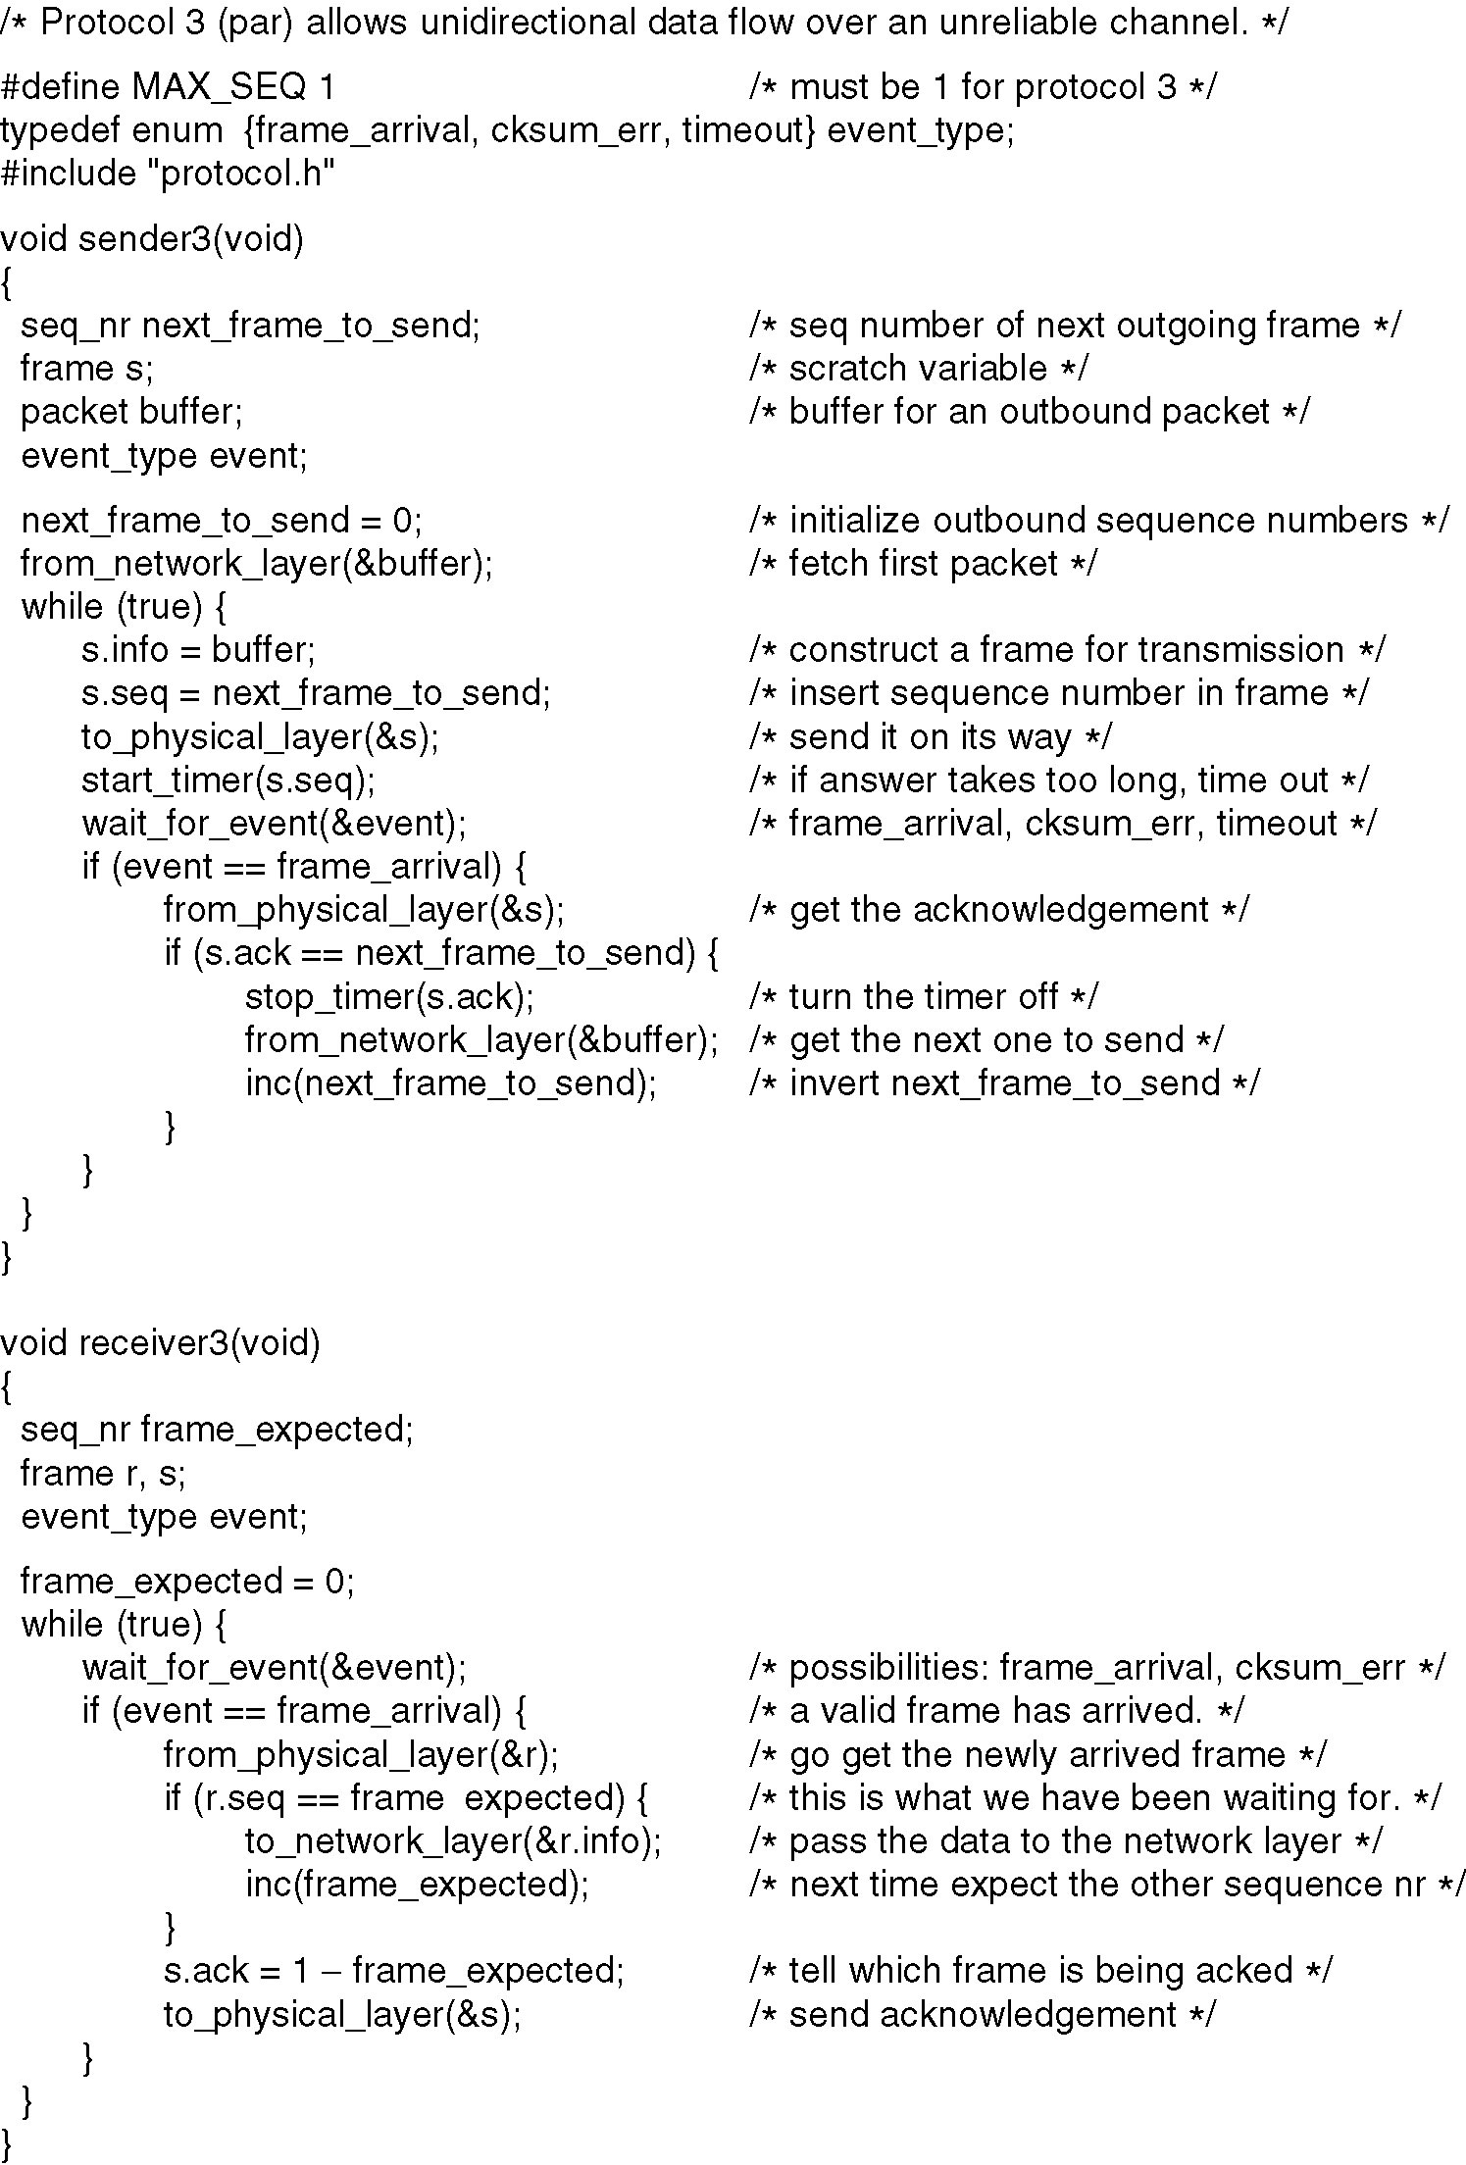
A Simplex Protocol for a Noisy Channel
A positive acknowledgement with retransmission protocol.
Send frame (or retransmission)
Set timer for retransmission
Wait for ack or timeout
If a good ack then set up for the next frame to send (else the old frame will be retransmitted)
Continued →

Slide 41
A Simplex Protocol for a Noisy Channel (ctd.)
Wait for a frame
If it’s new then take it and advance expected frame
Ack current frame
A positive acknowledgement with retransmission protocol.

Slide 42
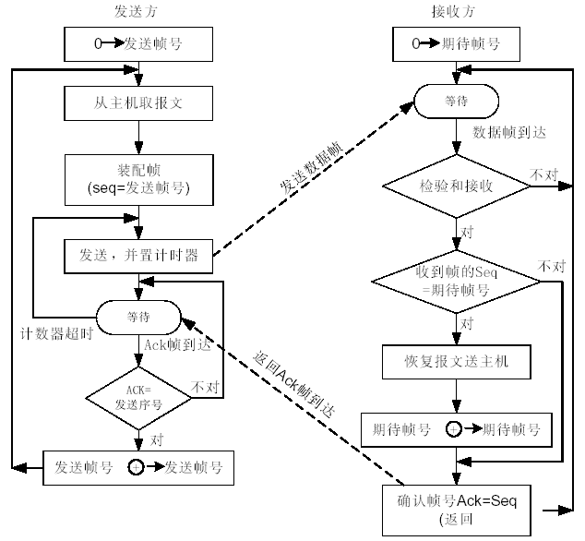
停等（stop-and-wait）协议的流程图

Slide 43
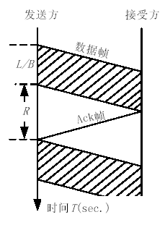
停—等协议的信道利用率
B is channel capacity (bits/sec)
L is frame size (bits)
R is round-trip propagation time (sec)

Slide 44
3.4 Sliding Window Protocols（滑动窗口协议）
Object: more efficient
A One-Bit Sliding Window Protocol
A Protocol Using Go Back N
A Protocol Using Selective Repeat

Slide 45
Some concepts
Transmit data in two direction
Piggybacking （捎带）
Sliding window
Sequence number
Size
Upper edge and Lower edge
Sending Window
The frame was sent but no ACK received
buffer
Receiving Window
Acceptable Frame

Slide 46
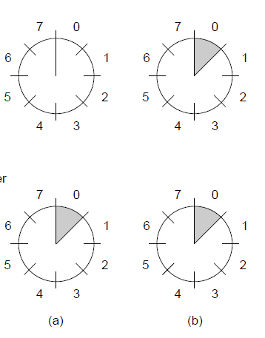
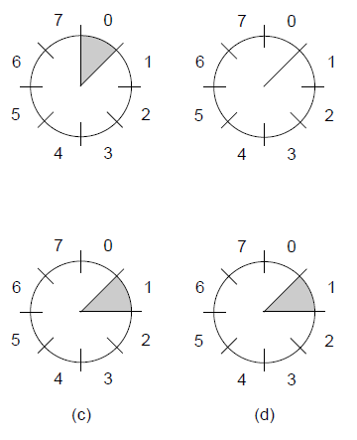
Sliding Window Protocols (2)
Sender
Receiver
A sliding window of size 1, with a 3-bit sequence number.
(a) Initially.
(b) After the first frame has been sent.
(c) After the first frame has been received.
(d) After the first acknowledgement has been received.

Slide 47
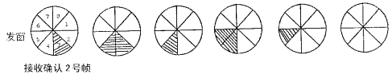
Sliding Window Protocols(3)
发送5号帧
接收确认5号帧
发送4号帧
接收确认3号帧
接收确认4号帧

Slide 48
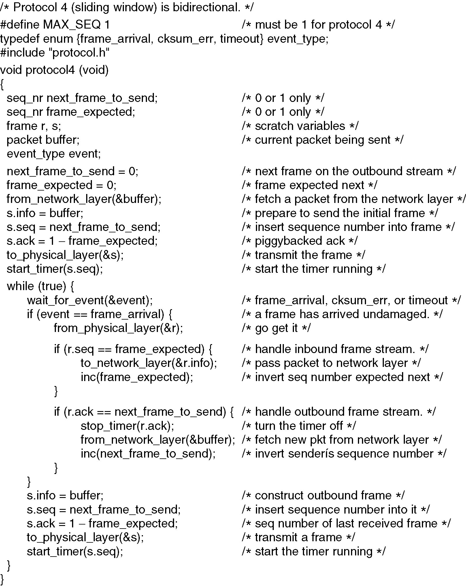
A One-Bit Sliding Window Protocol
Prepare first frame
Launch it, and set timer
Continued →

Slide 49
A One-Bit Sliding Window Protocol (ctd.)
Wait for frame or timeout
If a frame with new data then deliver it
If an ack for last send then prepare for next data frame
(Otherwise it was a timeout)
Send next data frame or retransmit old one; ack the last data we received

Slide 50
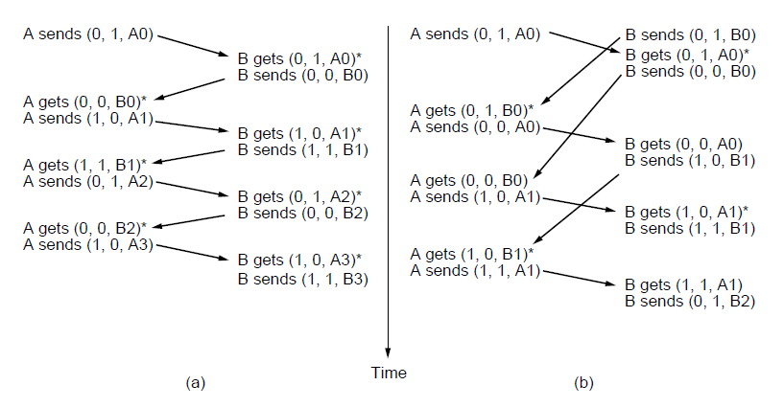
A One-Bit Sliding Window Protocol (2)
（a）
Time
（b）
Notation is (seq, ack, frame number). Asterisk indicates frame accepted by network layer .
Two scenarios for protocol 4. (a) Normal case. (b) Abnormal case.

Slide 51
A One-Bit Sliding Window Protocol (3)
B is channel capacity (bits/sec)
L is frame size (bits)
R is round-trip propagation time (sec)
The time needed to transmit a frame
L/B + R/2 + R/2
Line utilization = L / (L + B*R)
Pipelining（流水线）

Slide 52
讨论：
在协议4中
（1）当发送方在第48页倒数第2行语句中发送的一个数据帧丢失了，接收方执行何种动作？
（2）当发送方在第48页倒数第2行语句中发送的一个数据帧丢失了，发送方执行何种动作？
（3）当接收方正确收到发送方在第48页倒数第2行语句中发送的一个数据帧，并发送了该数据帧的确认，但该确认帧丢失了，发送方执行何种动作？

Slide 53
Sliding Window Protocol Using Go Back N（1）
Receiver’s window size is 1
Receiver only accept frame in order
Piggyback
Ack for frame n means n - 1, n - 2, and so on are also acknowledged.
Sending window < MAX_SEQ+1
No more than MAX_SEQ unacknowledged frames outstanding at any time
Bandwidth efficiency is lower
Buffer space is smaller

Slide 54
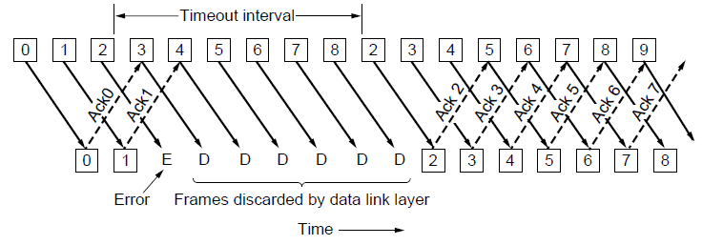
Go-Back-N (2)
Receiver only accepts/acks frames that arrive in order:
Discards frames that follow a missing/error frame
Sender times out and resends all outstanding frames

Slide 55
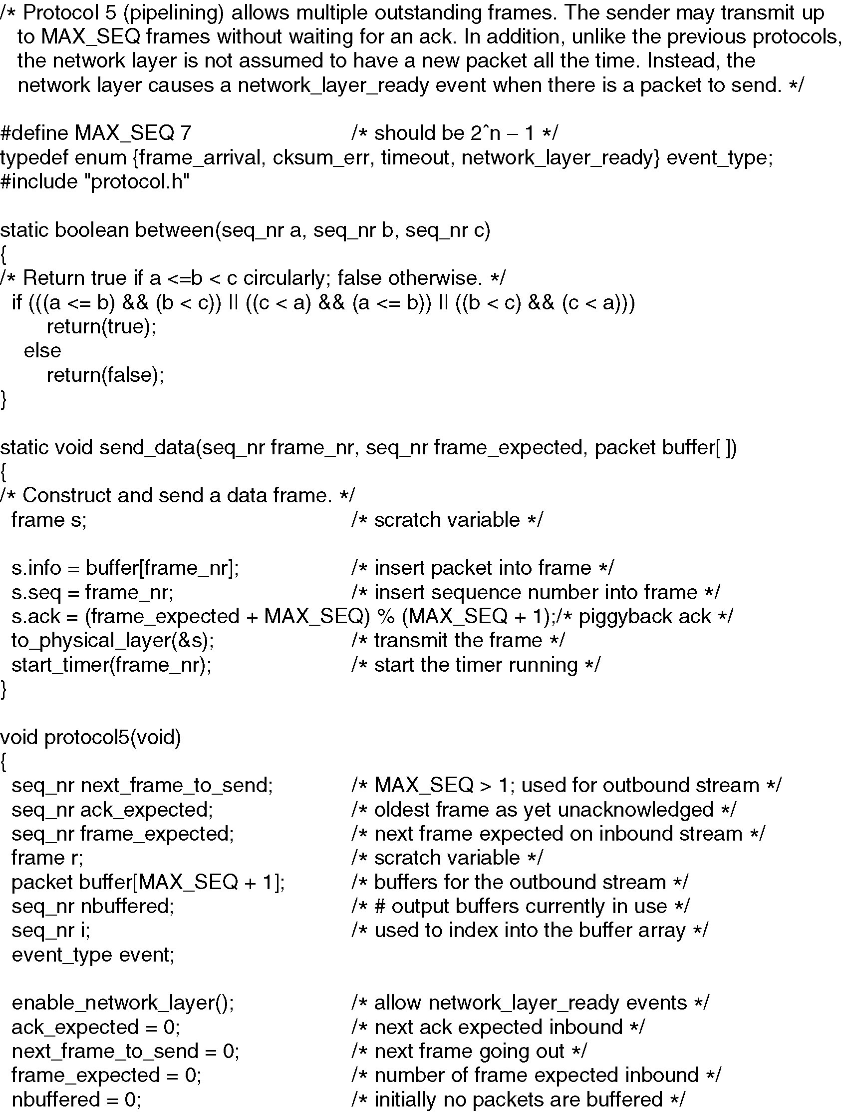
Go Back N（3）
Continued →

Slide 56
Go Back N（4）
Continued →

Slide 57
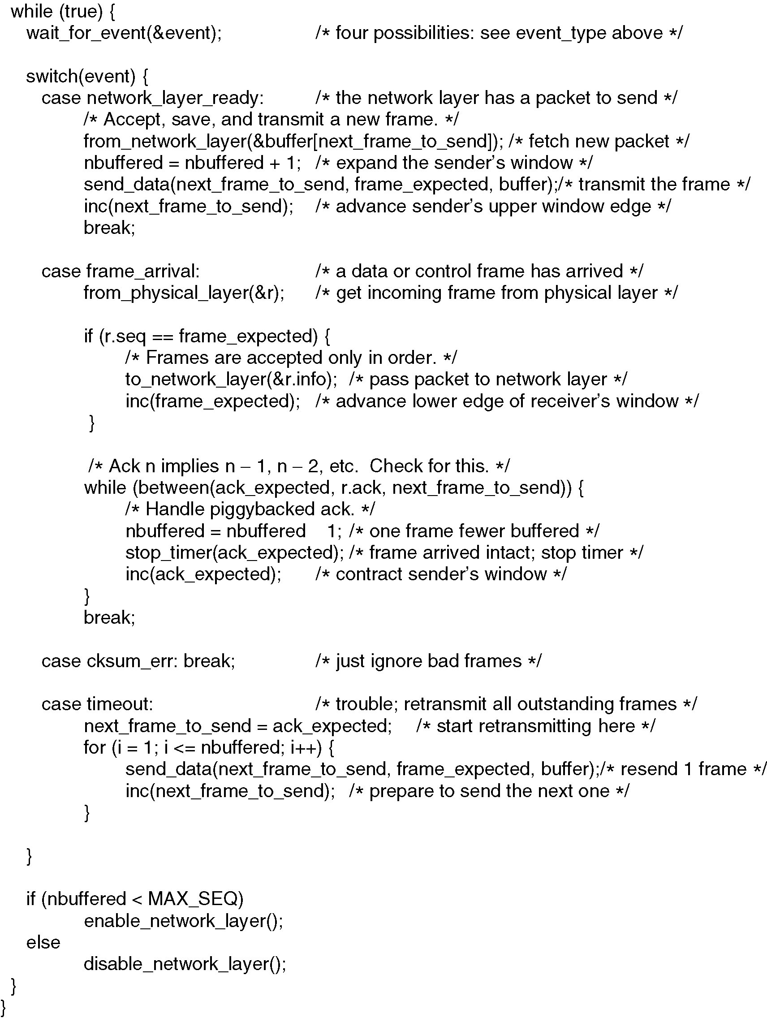
Go Back N（5）
Continued →

Slide 58
Go Back N（6）

Slide 59
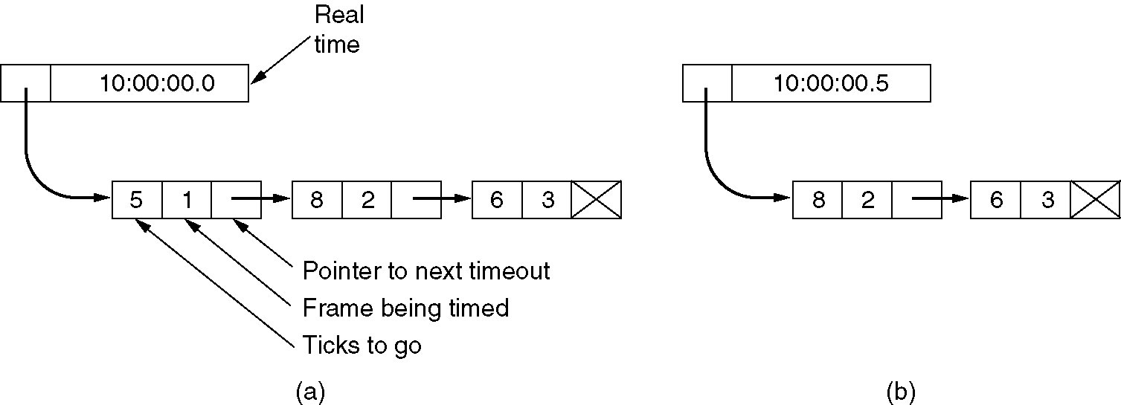
Go Back N (7)
Simulation of multiple timers in software.

Slide 60
A Sliding Window Protocol Using Selective Repeat（1）
Sending and receiving window is (MAX_SEQ+1)/2 （?）
Piggyback or independent to send ACK
Send NAK immediately when a error may happened
Bandwidth efficiency is higher
Buffer space is larger

Slide 61
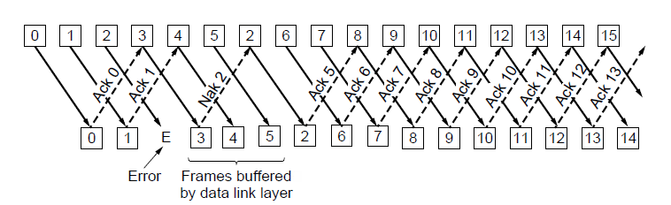
Selective Repeat（2）
Receiver accepts frames anywhere in receive window
Cumulative ack indicates highest in-order frame
NAK (negative ack) causes sender retransmission of a missing frame before a timeout resends window

Slide 62
A Sliding Window Protocol Using Selective Repeat（3）
Sending and receiving window is (MAX_SEQ+1)/2
S sends 0,1,2,3,4,5,6
R accepted and sends ACK0,1,2,3,4,5,6,but lost
S resend 0
R sends ACK6 (new 0 received, but no 7)
S sends 7 (0 to 6 received, so 7)
R accepts 7 and 0(the old one as new one)
S sends new 0, rejected by R

Slide 63
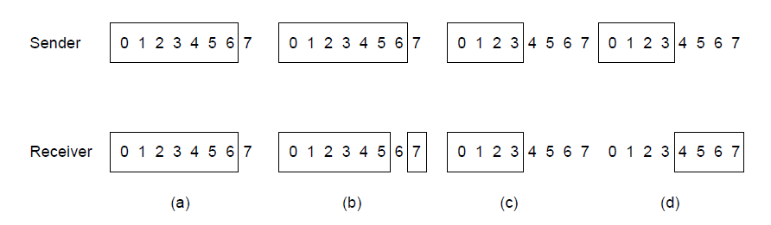
A Sliding Window Protocol Using Selective Repeat (4)
Originals
Retransmits
Originals
Retransmits
(a)
(b)
(c)
(d)
New receive window overlaps old – retransmits ambiguous
New and old receive window don’t overlap – no ambiguity
(a) Initial situation with a window size seven.
(b) After seven frames sent and received, but not acknowledged.
(c) Initial situation with a window size of four.
(d) After four frames sent and received, but not acknowledged.

Slide 64
A Sliding Window Protocol Using Selective Repeat（5）
Some parameters
Ack_Received
Ack_Expected
Next_Fram_To_Send
Frame_Expected
Too_far

Slide 65
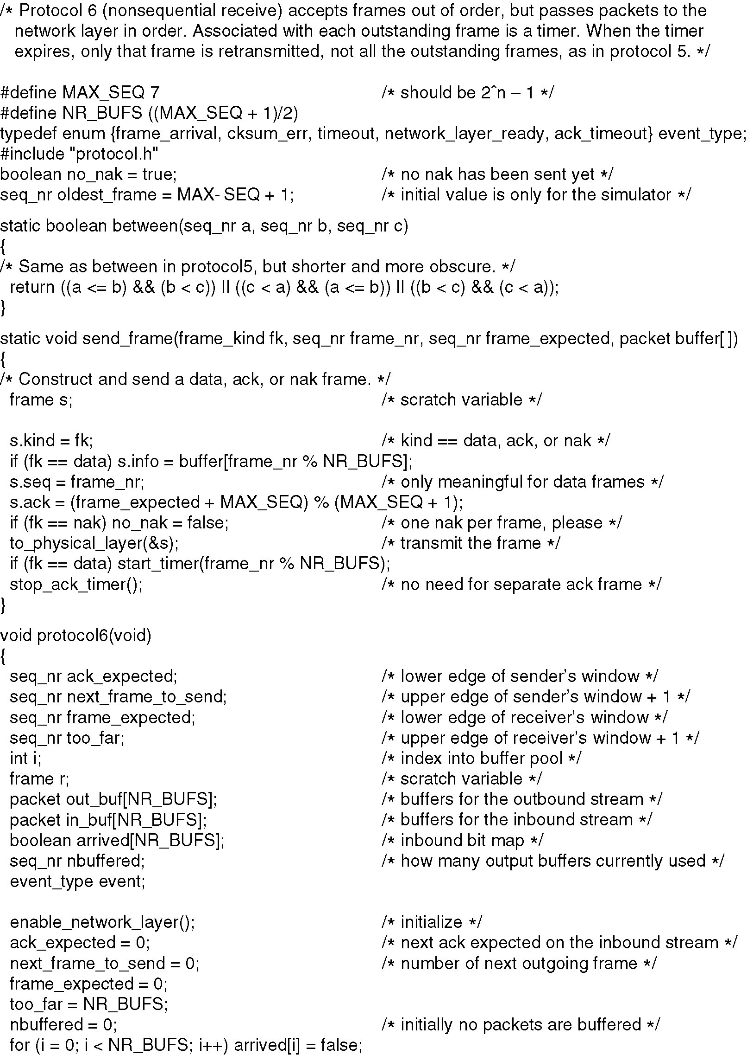
Selective Repeat（6）
Continued →

Slide 66
Selective Repeat (7)
Continued →

Slide 67
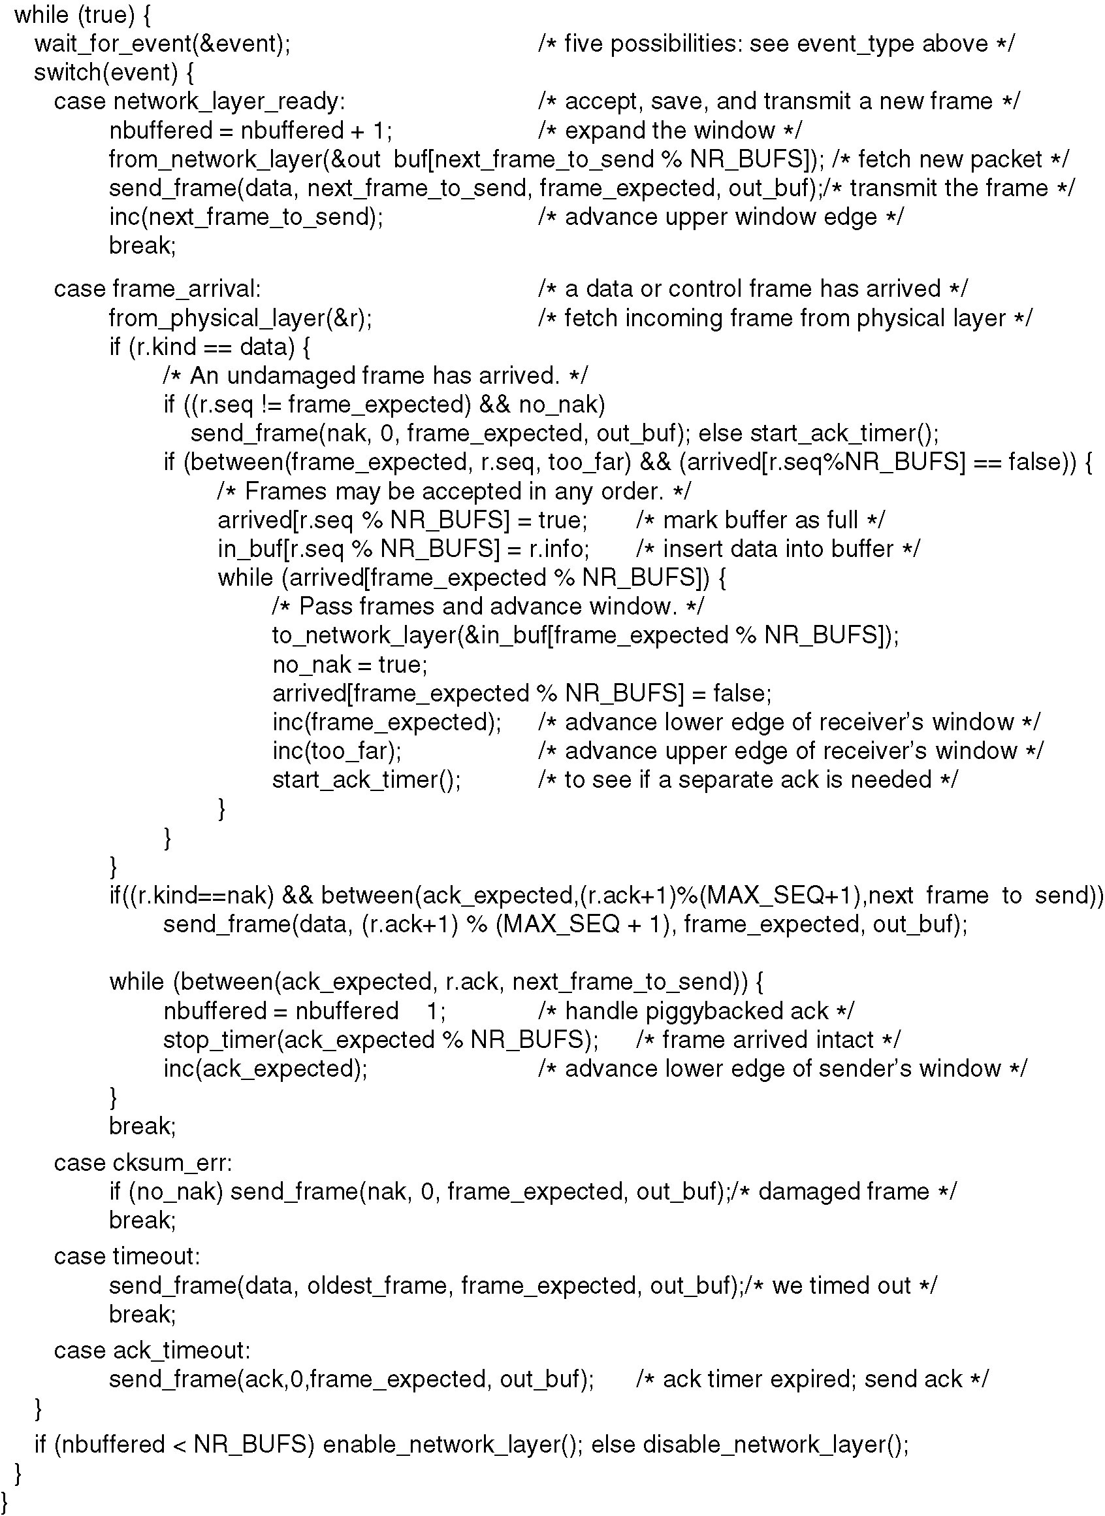
Selective Repeat (8)
Continued →

Slide 68
Selective Repeat (9)

Slide 69
例:长度为2000位的数据帧，在数据传输速率为1 M bps、最大长度为1 km的物理线路上传输。假设线路的单向传输延迟时间为199 ms，试计算下列协议中的物理通信线路可达到的最大利用率？（数据帧的序列号为4位，确认帧的发送时间忽略不计）
(1)停—等协议
(2)回退-n帧的滑动窗口协议
(3)选择性重传的滑动窗口协议

Slide 70
3.5 Example Data Link Protocols
Packet over SONET »
PPP (Point-to-Point Protocol) »
ADSL (Asymmetric Digital Subscriber Loop) »

Slide 71
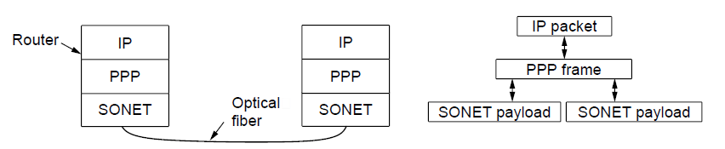
Packet over SONET
Packet over SONET is the method used to carry IP packets over SONET optical fiber links
Uses PPP (Point-to-Point Protocol) for framing
Protocol stacks
PPP frames may be split over SONET payloads

Slide 72
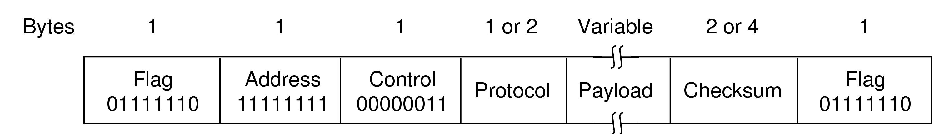
PPP (1)
PPP (Point-to-Point Protocol) is a general method for delivering packets across links
Framing uses a flag (0x7E) and byte stuffing
“Unnumbered mode” (connectionless unacknow-ledged service) is used to carry IP packets
Errors are detected with a checksum
标记域:01111110,字符填充;
地址域:总是被设置为11111111,表示所有站点都应该接受该帧。
控制域:缺省值为00000011,表示无序号帧,不提供使用序号和确认的可靠传输。
协议域:指示净负荷中是何种分组,缺省大小为2个字节。
净负荷域:变长,缺省为1500字节
校验和域:2或4个字节
0x21 for IPv4
IP packet

Slide 73
PPP协议（2）
PPP是点对点协议(Point-to-Point Protocol)的简称，它是一个工作于数据链路层的广域网协议。PPP由IETF (Internet Engineering Task Force)开发，目前已被广泛使用并成为国际标准。无论是同步电路还是异步电路，PPP协议都能够建立路由器之间或者主机到网络之间的连接。
PPP是面向字符的协议，采用字符填充的成帧技术。

Slide 74
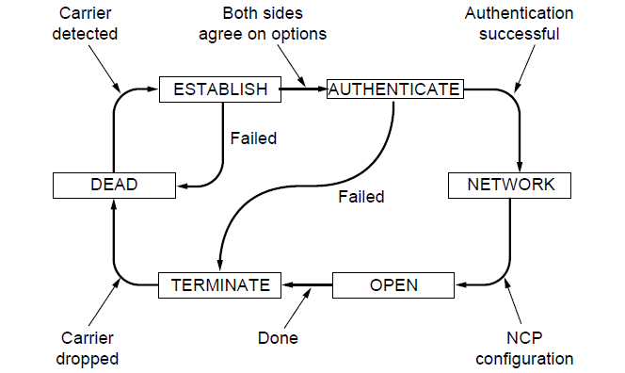
PPP (3)
A link control protocol brings the PPP link up/down
State machine for link control

Slide 75
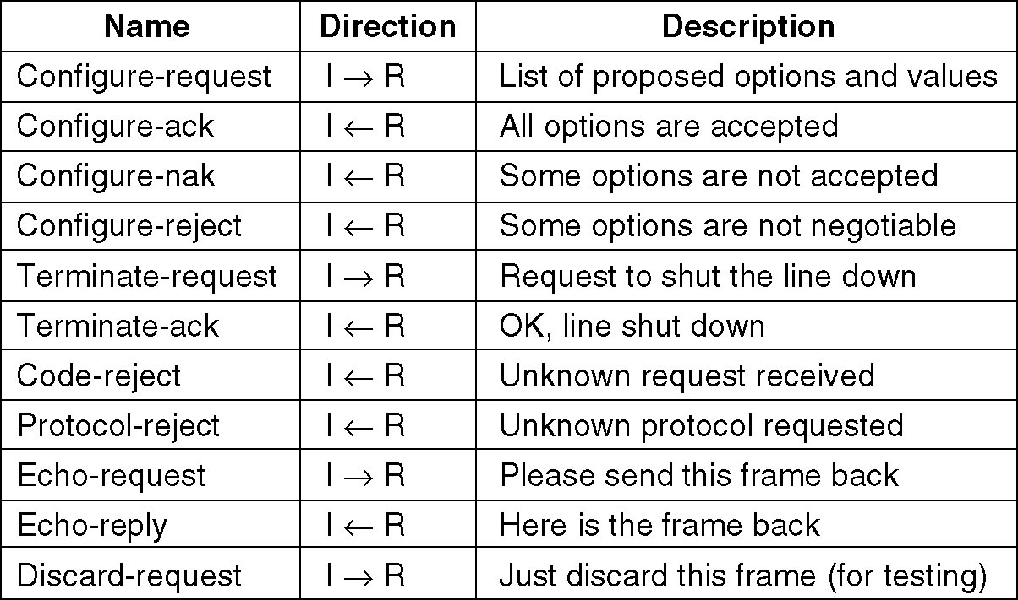
PPP – Point to Point Protocol (4)
The LCP frame types.

Slide 76
PPP会话建立的过程（5）
PPP提供了建立、配置、维护和终止点到点连接的方法。PPP经过以下4个阶段在一个点到点的链路上建立通信连接。
链路的建立和配置协调：通信的发起方发送LCP帧来配置和检测数据链路。LCP帧有链路建立帧、链路终止帧和链路维护帧三种。
链路质量检测：在链路建立、协调之后。这一阶段是可选的。主要用于对链路质量进行测试，以确定其能否为上层所选定的网络协议提供足够的支持，另外若连接的双方已经要求采用安全认证，则在该阶段还要按所选定的认证方式进行相应的身份认证。
网络层协议配置协调：通信的发起方发送NCP帧以选择并配置网络层协议。
关闭链路：通信链路将一直保持到LCP或NCP帧关闭链路或者是发生一些外部事件（如空闲时间超长或用户干预）。

Slide 77
PPP Architecture（6）
链路控制协议LCP (Link Control Protocol)用于数据链路连接的建立、配置与测试。
NCP (Network Control Protocol)是一组用来建立和配置不同的网络层协议。
IP
IPX
第三层 协议
IPCP IPXCP 其他协议
网络控制协议
网络层
PPP
认证和其他选项
链接控制协议
数据链路层
同步或异步物理介质
物理层
PPP协议结构

Slide 78
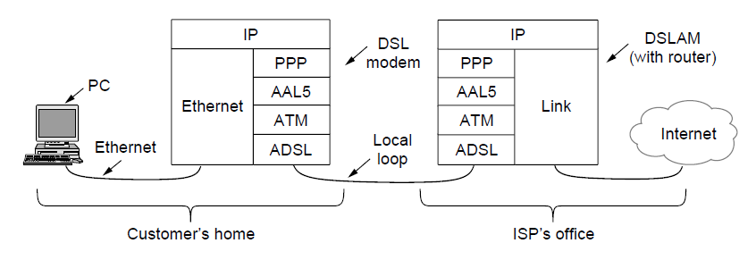
ADSL (1)
Widely used for broadband Internet over local loops
ADSL runs from modem (customer) to DSLAM (ISP)
IP packets are sent over PPP and AAL5/ATM (over)

Slide 79
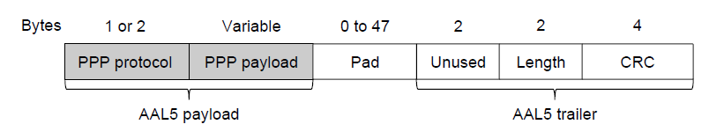
ADSL (2)
PPP data is sent in AAL5 frames over ATM cells:
ATM is a link layer that uses short, fixed-size cells (53 bytes); each cell has a virtual circuit identifier
AAL5 is a format to send packets over ATM
PPP frame is converted to a AAL5 frame (PPPoA)
AAL5 frame is divided into 48 byte pieces, each of which goes into one ATM cell with 5 header bytes
Notes:
Re ATM: ATM was a major technology in the 1990s that was hyped to win in the convergence of the Internet and telecommunications, but IP won instead. The short, fixed-size cells give flexibility (can mix voice and data without having the voice wait for a whole data packet). ATM is now used in niches such as ADSL and WAN links.

Slide 80
作业
3.2, 3.5, 3.7, 3.13, 3.14, 3.18, 3.20, 3.22, 3.23, 3.29

